Slide 1

AF Region PowerBI Workshop #1 July 20, 2023 Led by: Shazad Ahmed, OGHH PC/W
Notes:
-introduce myself, and my experience with PowerBI
-mention OGHH PowerBI products

Slide 2

PowerBI Workshop Objectives
Learn what PowerBI is
Understand how to utilize PowerBI for Peace Corps work
Build data literacy skills using PowerBI
Build PowerBI knowledge hub in AF region
Develop agency best practices for PowerBI

Slide 3
Workshop Structure
Convene once a month
Homework:
Facilitators will instruct what to watch for upcoming workshop
Watch prescribed LinkedIn learning videos on PowerBI before workshop
Possible exercises/practice
At Workshop:
Live demos/walkthroughs of concepts
Discussion/Q&A

Slide 4
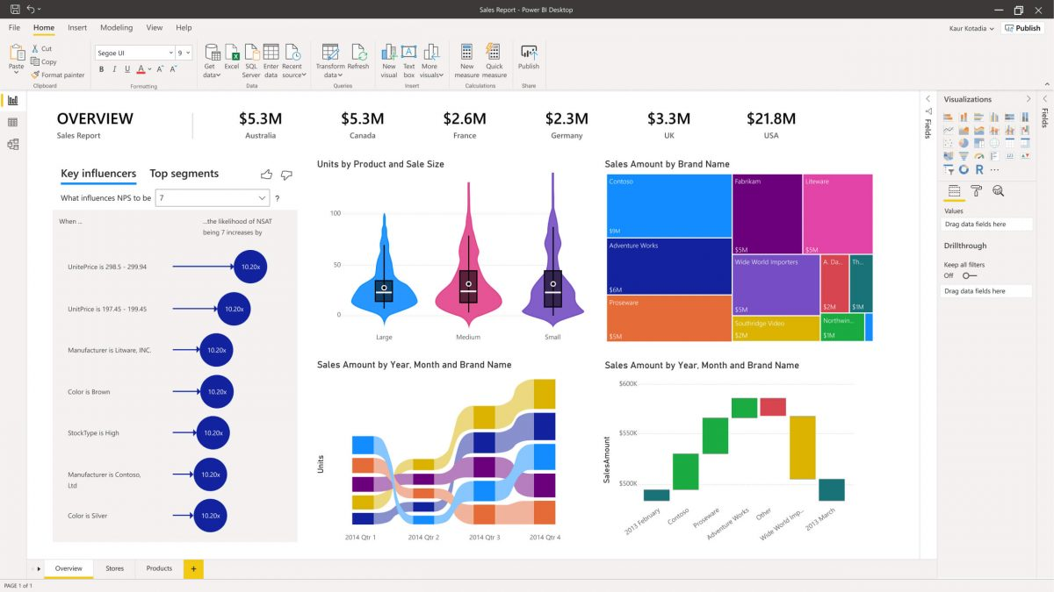
PowerBI Skills to be covered
Terminology
PowerBI products
Power Query data management
Import data
Creating visuals
Formatting visuals
Custom indicators/columns
Slicers
Exporting data/report
Publishing/Sharing

Slide 5
Workshop 1 Objectives
What is PowerBI?
Demo PowerBI Desktop and Online
Discuss concepts from LinkedInLearning videos
Discussion/Q&A

Slide 6
What is PowerBI?
Microsoft’s Business Intelligence (BI) platform
Business intelligence refers to leveraging insight from data and information to inform an organization or enterprise
BI platforms focus on analytics, information sharing, data management and more
Examples of BI platforms include PowerBI, Tableau, Microstrategy, SAS business & more
PowerBI is a collection of BI services & tools
Analytics, management, visualizations, reporting & more
Build meaningful visuals to support program M&E
Over 5 million users and 36% market share in data analytics

Slide 7
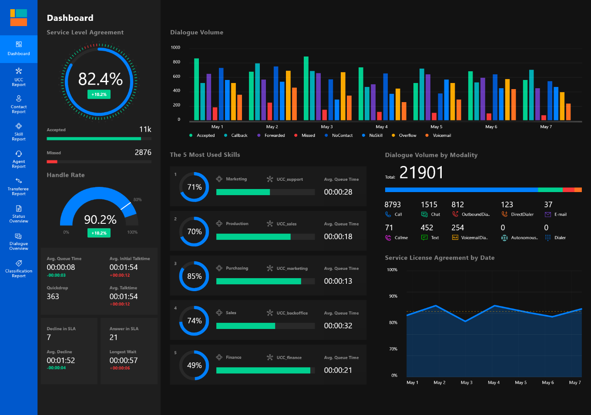
What is PowerBI? - Capabilities
Data management
Connectivity
Data modeling
Visualizations/Dashboarding
Real time reporting
Mobility
Sophisticated sharing
User rights management

Slide 8
What is PowerBI? – advantages
Point and click data management (Power Query)
Limitless* data processing
Data connectivity
Cool visualizations
Automation
Workspaces and user rights
Robust troubleshoot support
Interoperability with Microsoft suite
Notes:
*limited by computing power, unlike excel which has 1.04 million row limit

Slide 9
What is PowerBI? – Services
PowerBI desktop
Free – individual
Sits locally
Used to develop & create
Anyone in Peace Corps can download or request from OCIO
File type is .PBIX
PowerBI Service/Online
$$$
Online (powerbi.com)
Publish here
Sharing/viewing/ collaboration
Limited licenses in PC
PowerBI Mobile App
Part of PBI service
No capability at PC

Slide 10
Considerations
How do we want to utilize PowerBI?
Do you have PowerBI?
Should we create SOPs that all PC staff can follow?
Work flow
Data management
What is level of effort to learn PowerBI?
Does the workshop offer the right level of information?

Slide 11
Demo: Desktop & Online
Notes:
-introduce myself, and my experience with PowerBI
-mention OGHH PowerBI products

Slide 12
LinkedInLearning 1. Get Started with PowerBI (3 videos) 2. Getting Started with PowerBI (3 videos)
Notes:
-introduce myself, and my experience with PowerBI
-mention OGHH PowerBI products

Slide 13
Get Started with PowerBI
Business intelligence:
connecting facts about the business to its environment to make better decisions
Previously done at highest level by largest orgs
Done by IT to create reports for managers; big gap
Excel was an early solution
PowerBI
Data models
Many different visuals
“Dashboards” vs “reports”
PowerBI service: online, mobile apps, desktop

Slide 14
Get Started with PowerBI
Sign Up
Powerbi.microsoft.com
For Peace Corps, the process is different
Download desktop, request access to PowerBI online – website is different
Open PowerBI
Desktop is on computer
Online is https://app.powerbigov.us/home – this is what video focuses on
Home page has many options
Workspaces – where reports/dashboards reside

Slide 15
Getting Started with PowerBI
Install App
Apps available through org
We really don’t have any
Explore sample application
Explores sample app – we don’t have that
Explores a dashboard & report
Ask question with Q&A
Cool feature in reports and dashboards – can hone in on data

Slide 16
Q&A

